Slide 1
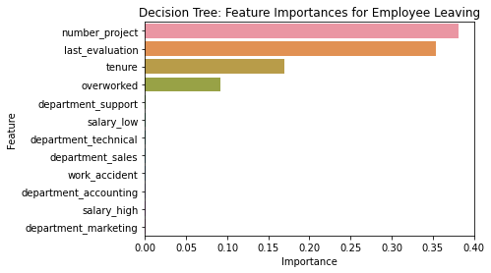
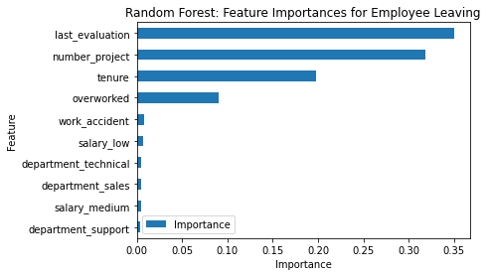
Salifort Motors
Employee Retention Project
Salifort Motors seeks to improve employee retention and answer the question:
What’s likely to make the employee leave the company?
Since the variable we are seeking to predict is categorical, either a logistic regression or a tree-based machine learning model could be used.
Both were built, but the random forest model outperforms the decision tree model.
Barplot above shows the most relevant variables: ‘last_evaluation’, ‘number_project’, ‘tenure’ and ‘overworked’.
This model helps predict whether an employee will leave and identify which factors are most influential. These insights can help HR make decisions to improve employee retention.
In the random forest model above, `last_evaluation`, `tenure`, `number_project`, `overworked`, `salary_low`, and `work_accident` have the highest importance. These variables are most helpful in predicting the outcome variable, `left`.
Promote hiring programs and scale up the number of workers, if possible, to dilute the work among more employees (to increase satisfaction and decrease overwork)
Adjust evaluation scores so employees are rewarded for their work (would increase determination) in proportion to the results generated for the company.
Limit the number of projects an employee can be involved (3 or 4 would be a good number, statistically).
Promote more analysis for employees that have been with the company for 4 years and seek to understand their low level of satisfaction. Also, consider promotion programs for them.
Organize company-wide awareness programs in order to inform workers about the company's culture ands expectations. That would align the expectations and plans of all stakeholders.

